Slide 1
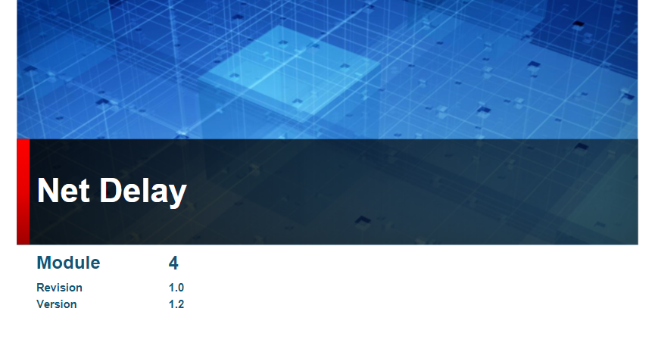

Slide 2
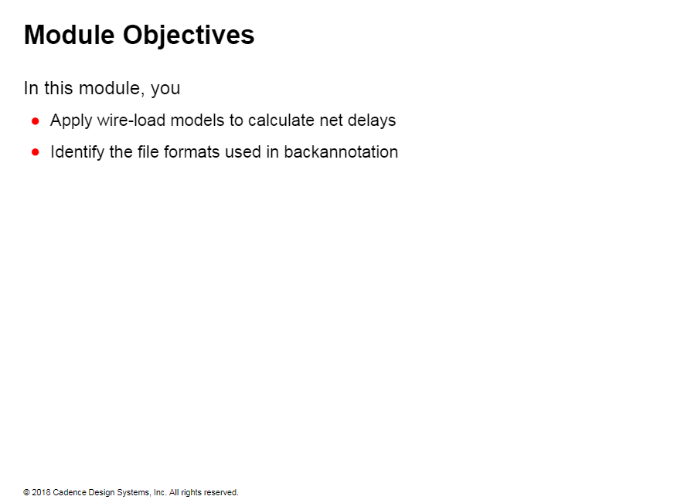

Slide 3
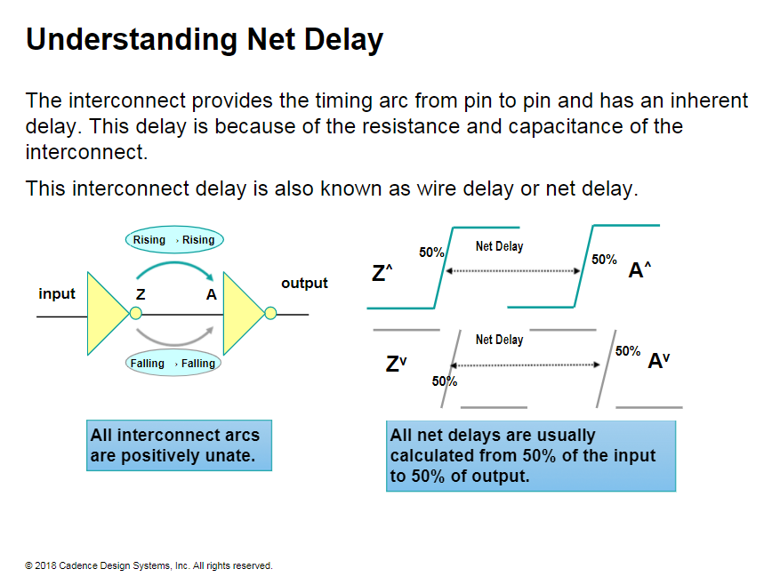
Notes:
In the illustration on the top-right. even though a falling transition on input will eventually cause a falling transition on output, there are no explicit timing arcs connecting them.
The timing arc of the net connects the pin-to-pin timing arcs of the cells.
To get from input to output, you need to traverse several timing arcs. This combination of timing arcs defines a path. Most timing tools use both the rise and fall transitions. and calculate the worst-case delay for the path.

Slide 4
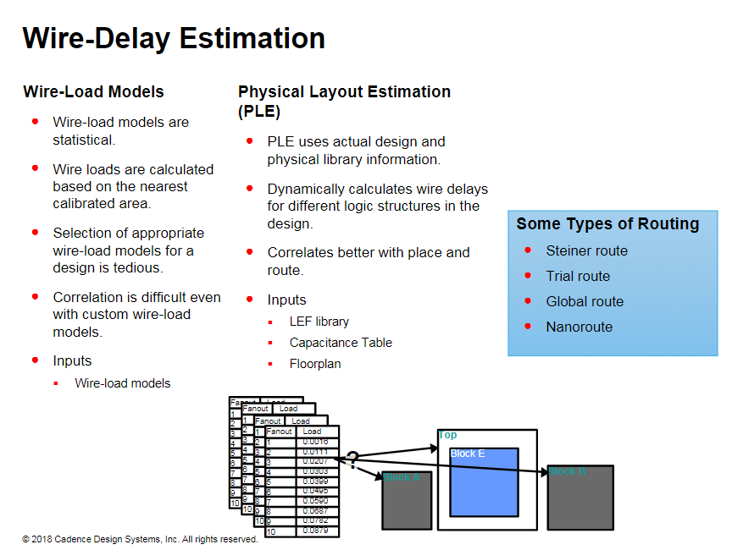
Notes:
PLE is a physical modeling technique that bypasses wire loads for RTL synthesis optimization. In place of wire loads, the synthesis tool uses an equation to model the wire delay. 1- PLE removes the reliance on user-supplied WLMs. 2- PLE is neither too optimistic or too pessimistic.

Slide 5
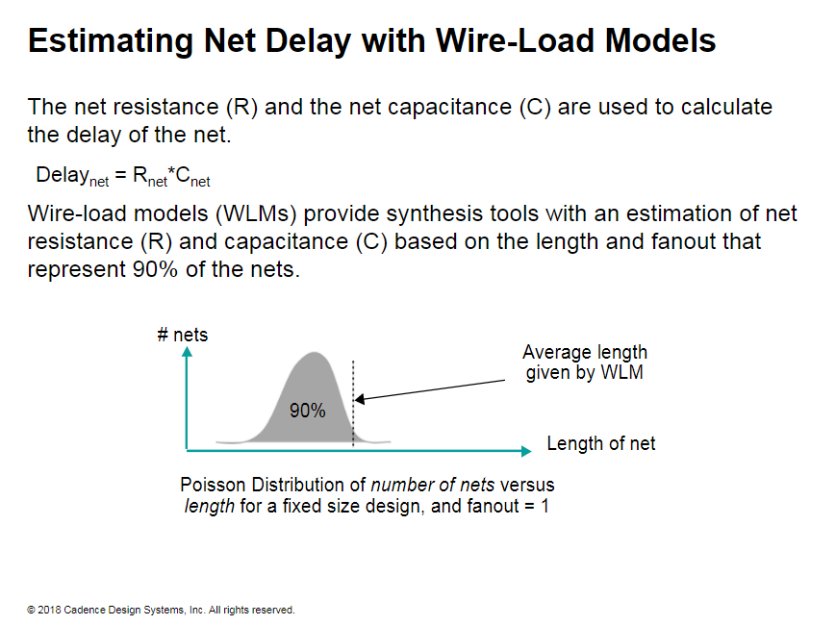
Notes:
However, even with the best WLM estimates, you cannot get the accuracy of physical data.
Based on many designs, the average statistical net length, representing 90% of the nets, is determined using a Poisson distribution. This average length is used to calculate the WLMs.
WLMs are usually statistically weighted so that the value reported by the WLM for capacitance and resistance is pessimistic.
Because these wire loads are statistical and pessimistic, they might be unreliable for some designs. However, because they provide an estimate, they are widely used for critical path analysis, and also as a stating point for synthesis.

Slide 6
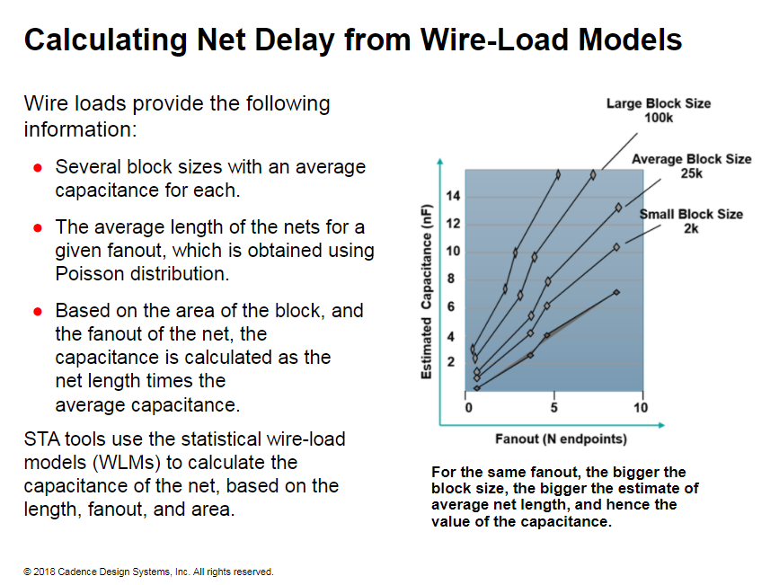
Notes:
How does an STA tool calculate net delay from a WLM?
Determine the area that a net ﬁts in.
From the wire-load selection table, select the WLM with a block area that just encloses the area of the net.
Use the WLM to estimate the wire length based on the fanout of the net or use the wire-load table to model capacitance and resistance more accurately.
The capacitance multiplier (CM) and resistance Multiplier (RM) are used to determine the actual RCs of the net, using the following: Cnet = CM* length , Rnet = RM
The delay of the net is calculated using: Delay = Rnet* Cnet
You can use custom wire-load models generated from the place and route tools, or use the statistical wire-load models in the library provided by the vendor, to calculate net delays.

Slide 7
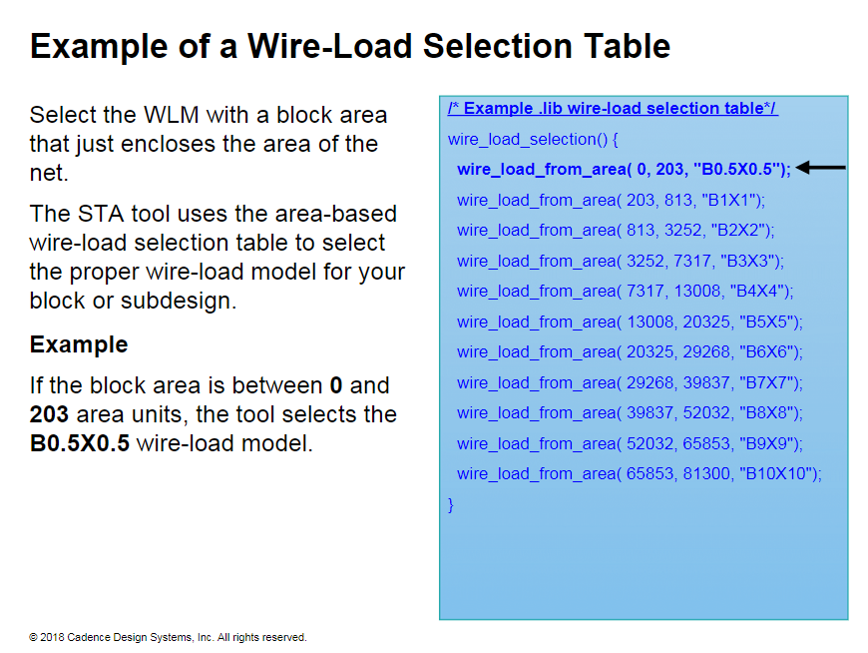

Slide 8
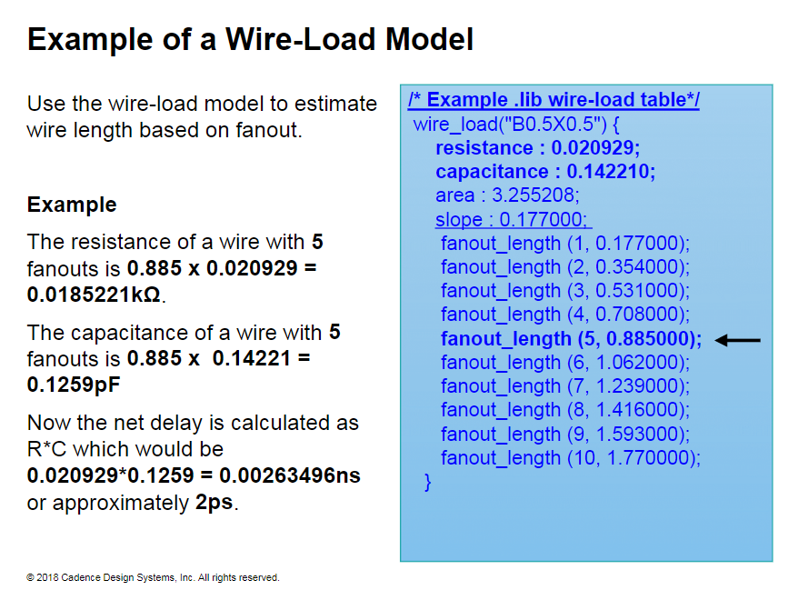
Notes:
For fanouts larger than those listed in the table, the STA tool uses the slope value to calculate the corresponding length of the wire.
Wire-Load Tables
Wire-load tables are another form of wire-load models.
The advantage of wire-load tables is their accuracy.
Use wire-load tables to model more accurate wire capacitance and resistance based on fanout.
The disadvantage of these tables is that the libraries are larger, and the characterization of these tables takes longer.
/*Example .lib more accurate wire-load table*/ wire_load_table (wlmode 10) { fanout length ( 5 , 0.08 ); fanout_capacitance( 5 , 0.13 ) ; fanout_resistance( 5 , 0.03) ,’ fanout_area( 5 , 0.02) ; }

Slide 9
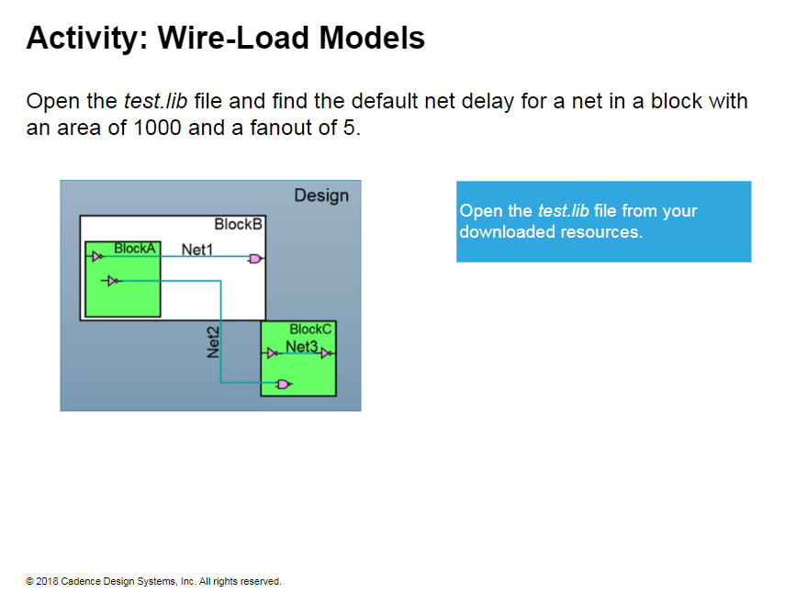
Notes:
Solution In the test.lib ﬁle, you ﬁnd: default_wire_load: "TSMC13_Conservative“; In the TSMC13_Conservative wire-load, for an area of 1 unit: The capacitance multiplier is 0.002993. The capacitance for a fanout length of 5 is 0.01007*0.002993. The resistance multiplier is 0. Therefore, the delay of the net is R*C = 0.

Slide 10
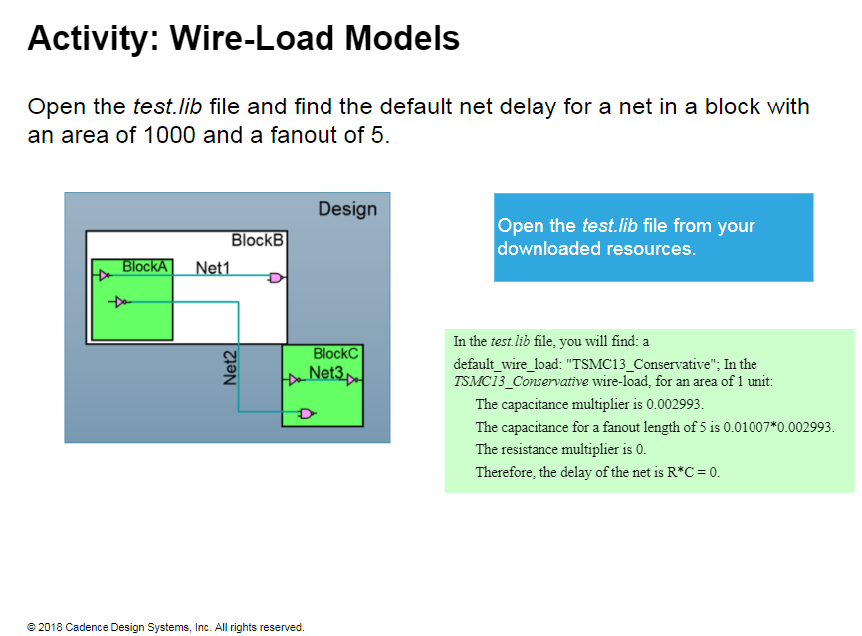

Slide 11
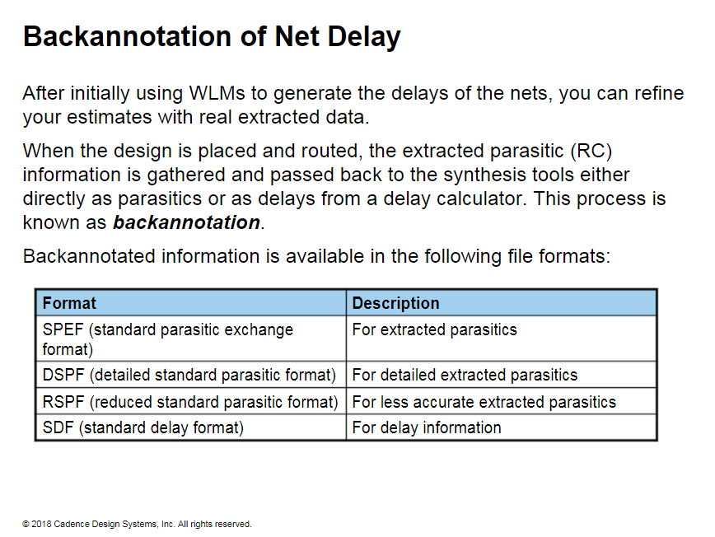

Slide 12
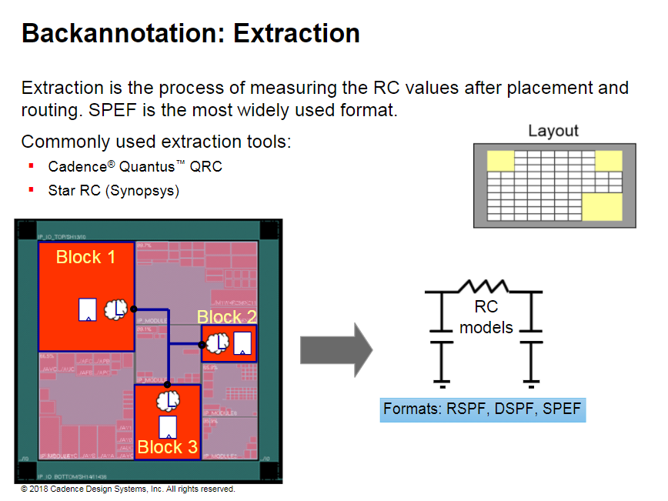
Notes:
Tools such as Cadence Quantus QRC extract the RC values from the layout using RC models. These values are backannotated to the STA tools in one of the SPEF formats.
The layout in this illustration is place-and-route data. From this layout, you extract the resistance and capacitance of the nets and cells within the design .
The extracted RC data is fed back to the STA tool in one of the three formats. Each of these formats uses different extraction compression based on the different models.

Slide 13
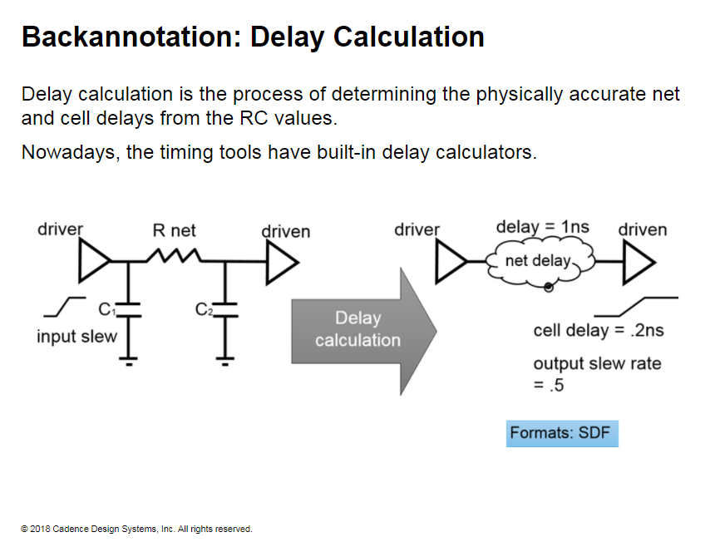
Notes:
In this illustration, the delay calculator converts the extracted RC values to cell and net delays in the form of an SDF file for Static Time Analysis

Slide 14
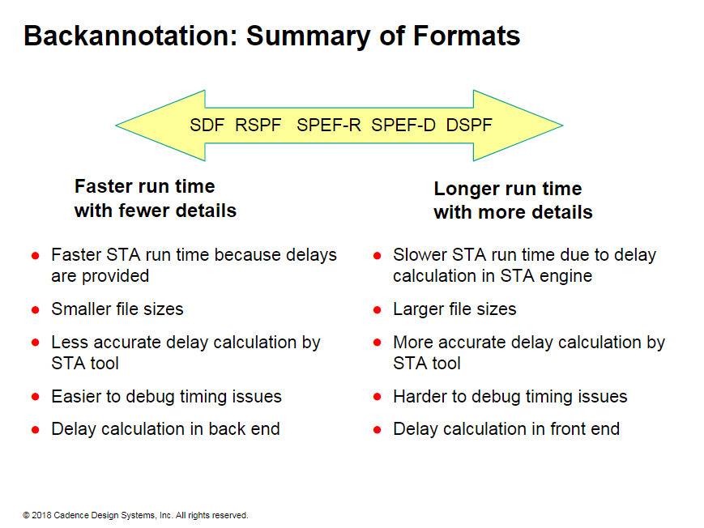

Slide 15
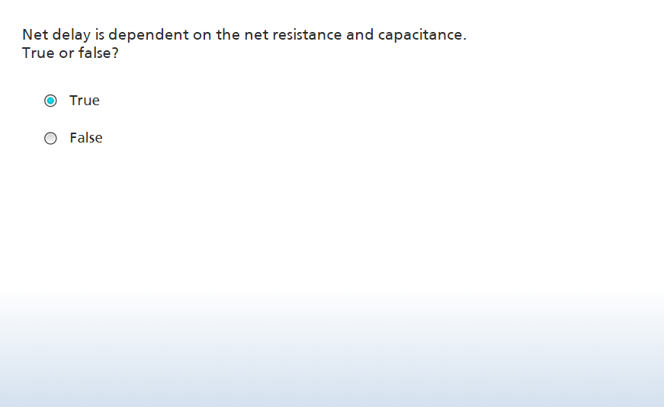

Slide 16
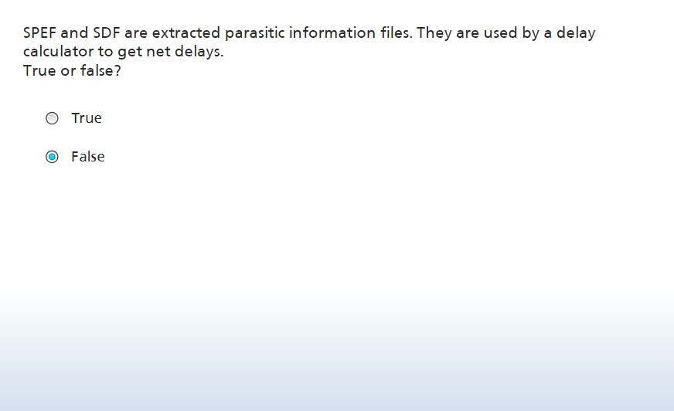

Slide 17


Slide 18
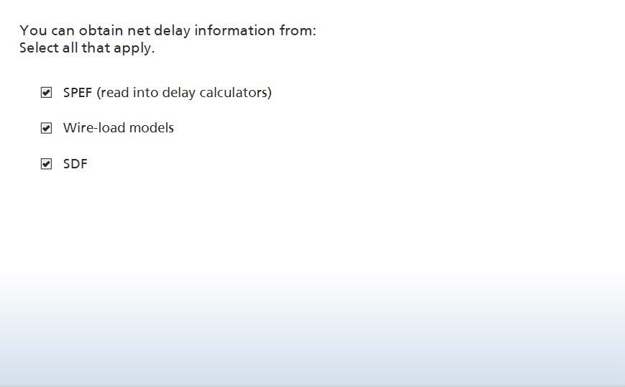

Slide 19
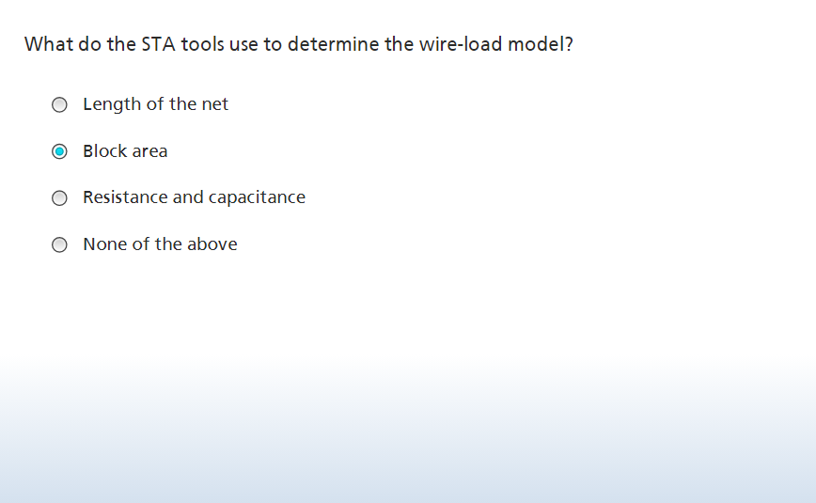

Slide 20
